Slide 1
Spam Detector
Spam/Ham Mails

Slide 2
What is Spam?
Spam email is unsolicited and unwanted junk email sent out in bulk to an indiscriminate recipient list. Typically, spam is sent for commercial purposes. It can be sent in massive volume by botnets, networks of infected computers.

Slide 3
Common types of spam
Commercial advertisements
Antivirus warnings
Email spoofing
Sweepstakes winners
Money scams

Slide 4
How do you stop spam email?
This is where the magic of data science comes into place.
Spam email can be difficult to stop, as it can be sent from botnets. Botnets are a network of previously infected computers. As a result, the original spammer can be difficult to trace and stop.
If you receive a message that appears to be spam--for example, if you don’t recognize the sender--mark the message as spam in your email application. Don't click any links or attached files, including opt-out or unsubscribe links. Spammers sometimes include these links to confirm that your email address is legitimate, or the links may trigger malicious webpages or downloads.

Slide 5
Data Set
I got my data set from kaggle.com.
I analyzed my data step by step and performed all the steps.
1st I got the raw data from kaggle.com
Then data processing was performed.
Then data was cleaned for any duplications etc.
After cleaning the data, I performed exploratory data analysis in which I applied different statistical analysis.
A good algorithm is the key to success here provided the above steps were done carefully.
So I picked up Naïve Bayes algorithm and used it in this model.

Slide 6
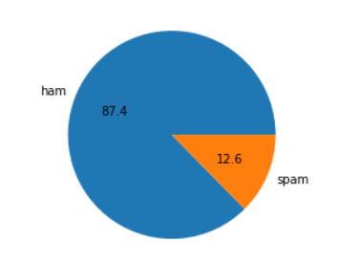
Pie chart of the data set

Slide 7
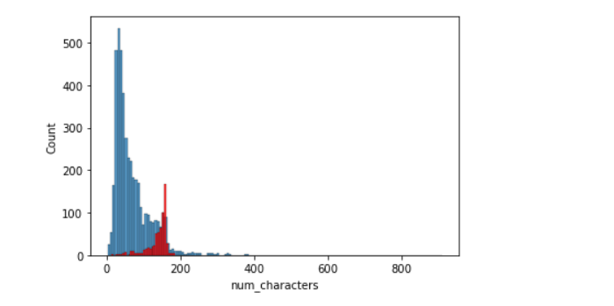
Histogram of the data set

Slide 8
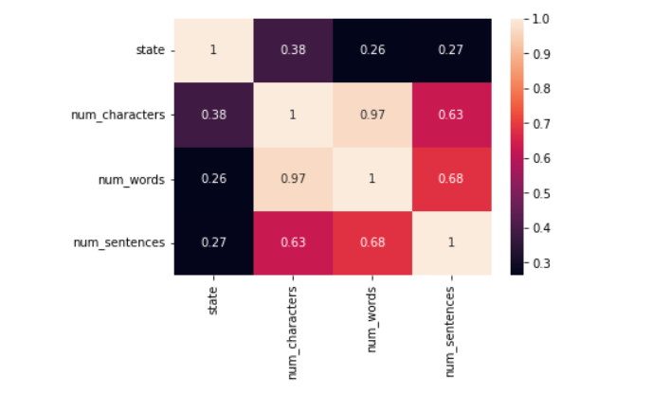
Heat map of the data set

Slide 9
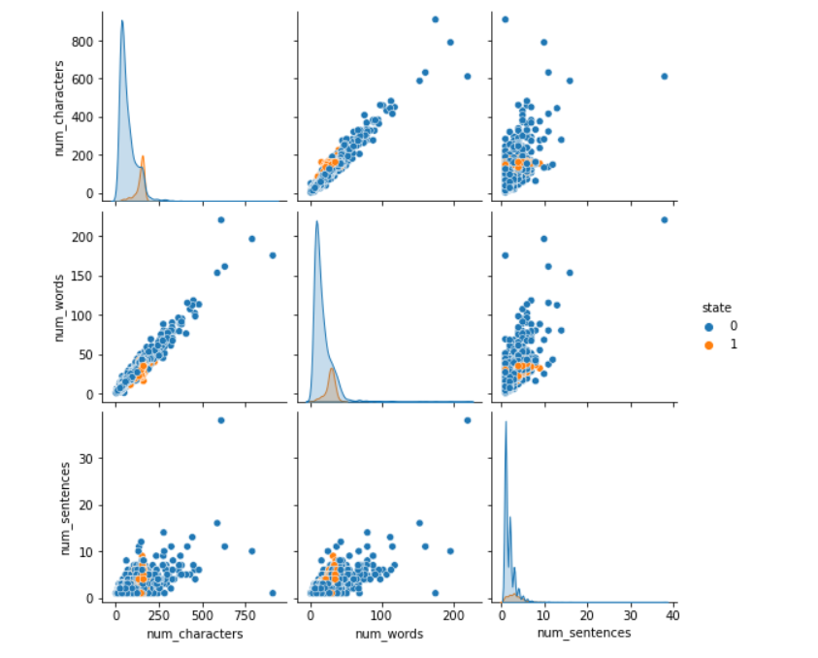
Pair plot of the data set

Slide 10
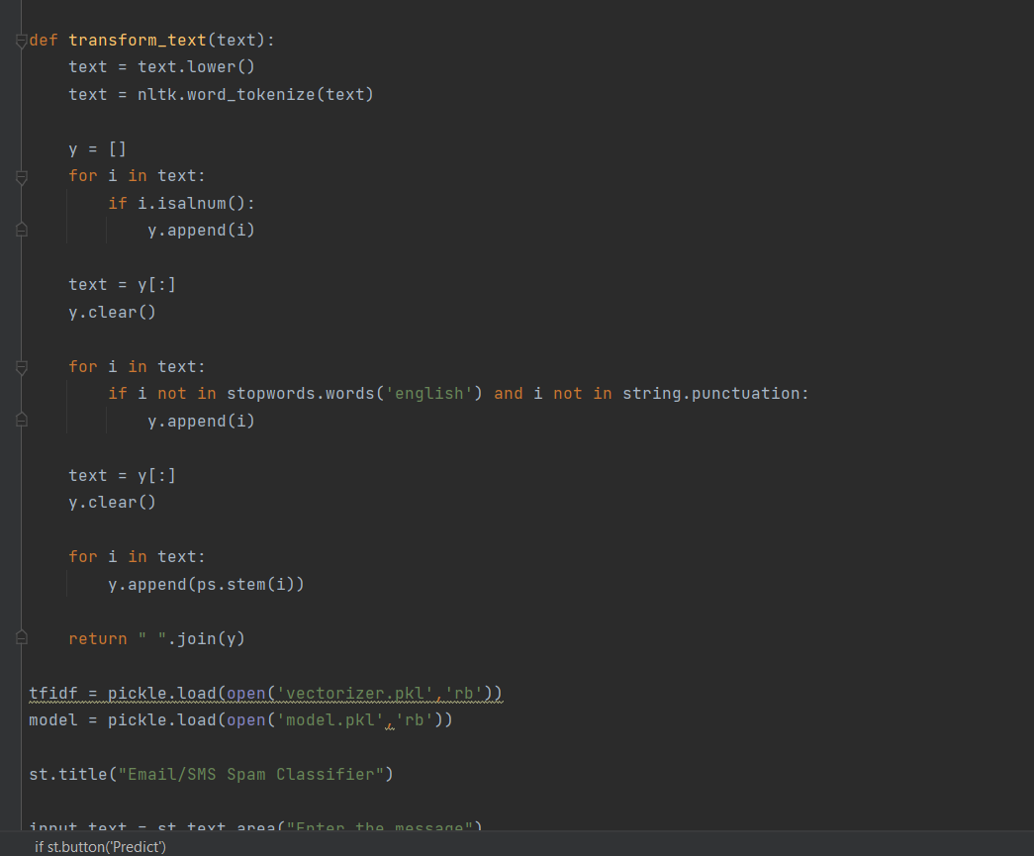
Screenshots of code and its execution

Slide 11
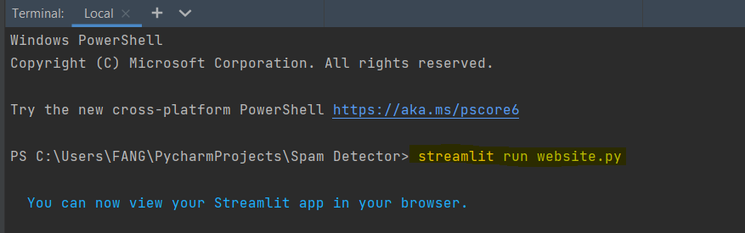

Slide 12
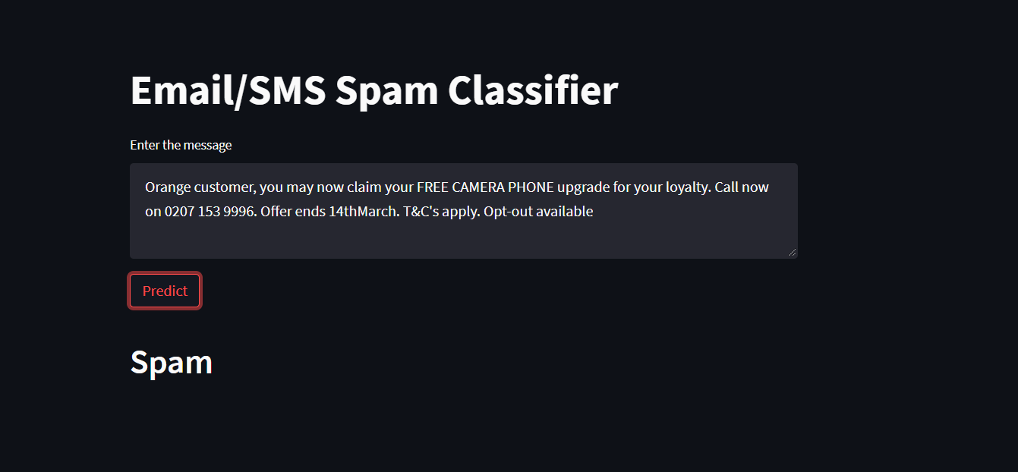
Screenshot of detection

Slide 13
